Slide 1
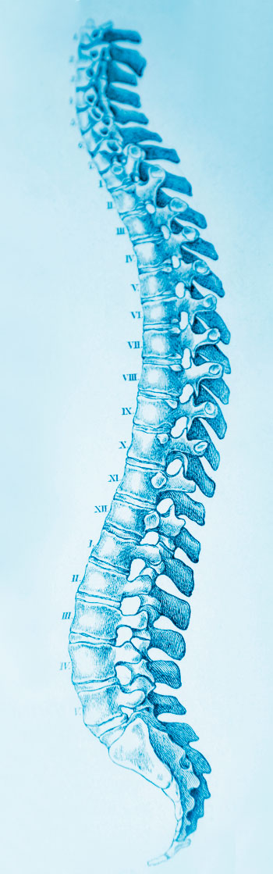
PROJECT CONTRIBUTORS :
SHAIKH FALAK QAMAR-211249
SHAIKH FIRDOS BASHIR-211250
YASMEEN ZUBER -211261
A FUTURISITIC APPROACH TO DETECT ANKYLOSING SPONDYLITIS
SE COMPS Mini Project 1B
Mentor : Prof. Asadullah Shaikh

Slide 2
Table of Contents
INTRODUCTION TO AS
PERFORMANCE MEASURE
SOLUTION TO PROBLEMS
CURRENT STATUS
ALGORITHMS
STEPS FOR CLOUD

Slide 3

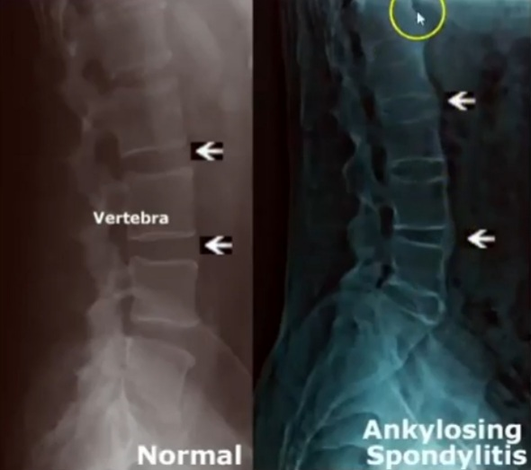
What is Ankylosing Spondylitis?
Ankylosing spondylitis (AS) is a chronic progressive inflammatory disease of the spine. Major problem is Delayed Diagnosis. It is an auto immune disease.
AS originates clearly from the sacroiliac joint.
Indicators
Age onset: before 40 years.
Lower Back Pain for more than 3 months.
Pain in the ankle, heel, hip, lower back, neck or shoulders.
Morning Stiffness for more than 30 mins.
Gets worse on rest, improves on movement.
Inflammation in eyes-(Uveitis).
A rigid spine.

Slide 4
What is our solution to the problem?
Technologies used:
Streamlit-A free and open source framework to build beautiful ML and data science apps. Python based library specifically.
Anacondo-A software that create an environment for many different packafes of python.
Spyder-Open source scientific environment for python ,debugging, editing, and more
Our website is a one stop solution to find out if the backpain is one of the symptoms of Ankylosing Spondylitis.
The multiple features of our site:
AS test
Behind backpain
Backsplaining AS
Locate a Rheumatalogist

Slide 5
Algorithms studied
SVM
Logistic regression
Support Vector Machine is simple .The algorithm creates a line or hyperplane which seperates the data into classes.
Logistic regression is used to predict the probability of binary(yes/no) event occurring.
Gradient boost
Gradient boost algorithm is used to build model sequentially and subsequent models try to reduce the errors of the previous model.

Slide 6
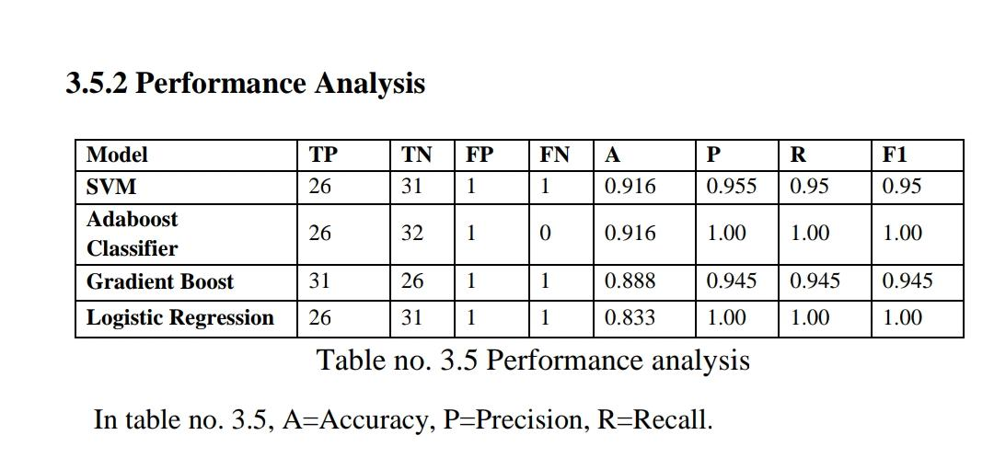
Why elected SVM
LIST OF ABBREVATIONS:
TP-TRUE POSITIVE.
TN-TRUE NEGATIVE
FP-FALSE POSITIVE.
FN-FALSE NEGATIVE

Slide 7
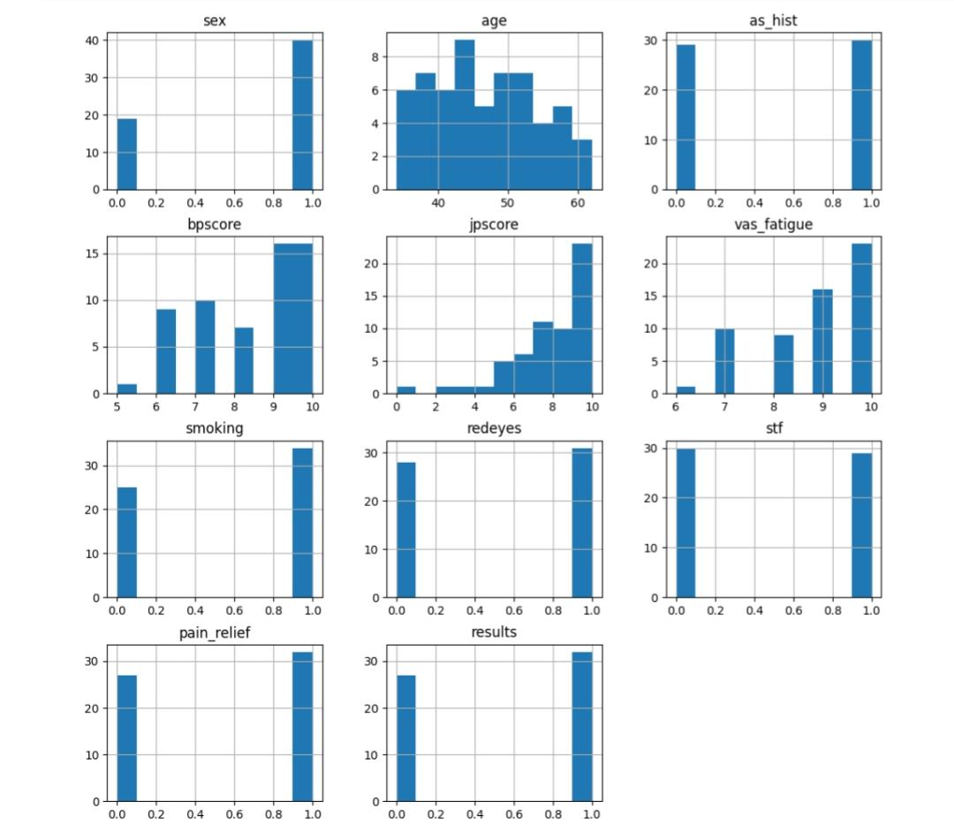
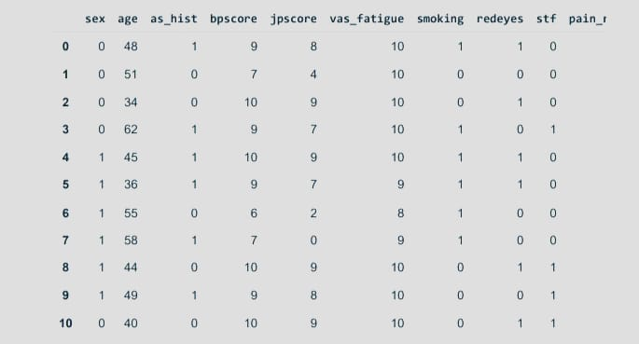
NOTE:
A customized data set created with current Research paper based knowledge.
The dataset is design carefully under the supervision of medical staff

Slide 8
IMPLEMENTATION
01
Custom Dataset and Survey
Hardware | Laptop
Coding Language | Python
Software Applications | Anaconda Spyder
System Requirement | 4.0 GB RAM Intel or AMD x86–64 processor
Operating System | Windows 11 Windows 10
Machine Learning Libraries | Pandas Numpy Scikit learn
Machine learning Algorithms | SVM Adaboost Gradient Boost
Web Application Framework | Streamlit
Cloud Platform | Render
Supported Web Browsers | Latest versions of Google Chrome, Firefox, Microsoft Edge, and Safari
Version Control System | Git
ML Algorithms testing
02
03
Streamlit Web Application Framework
04
Deployment on Render Cloud

Slide 9
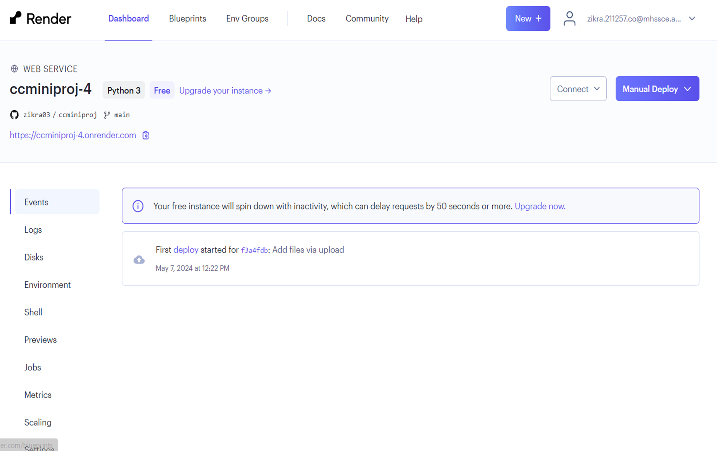
STEPS FOR CLOUD RENDER
1. Linked Git repository containing the Streamlit app code to Render.
2. Configured the build command (e.g., `pip install -r requirements.txt`) to install dependencies within Render.
3. Set the start command (e.g., `streamlit run app.py`) to launch the app upon deployment.
4. Initiated deployment by clicking "Create Web Service" in Render.
5. Accessed deployed Streamlit application using the provided URL.

Slide 10
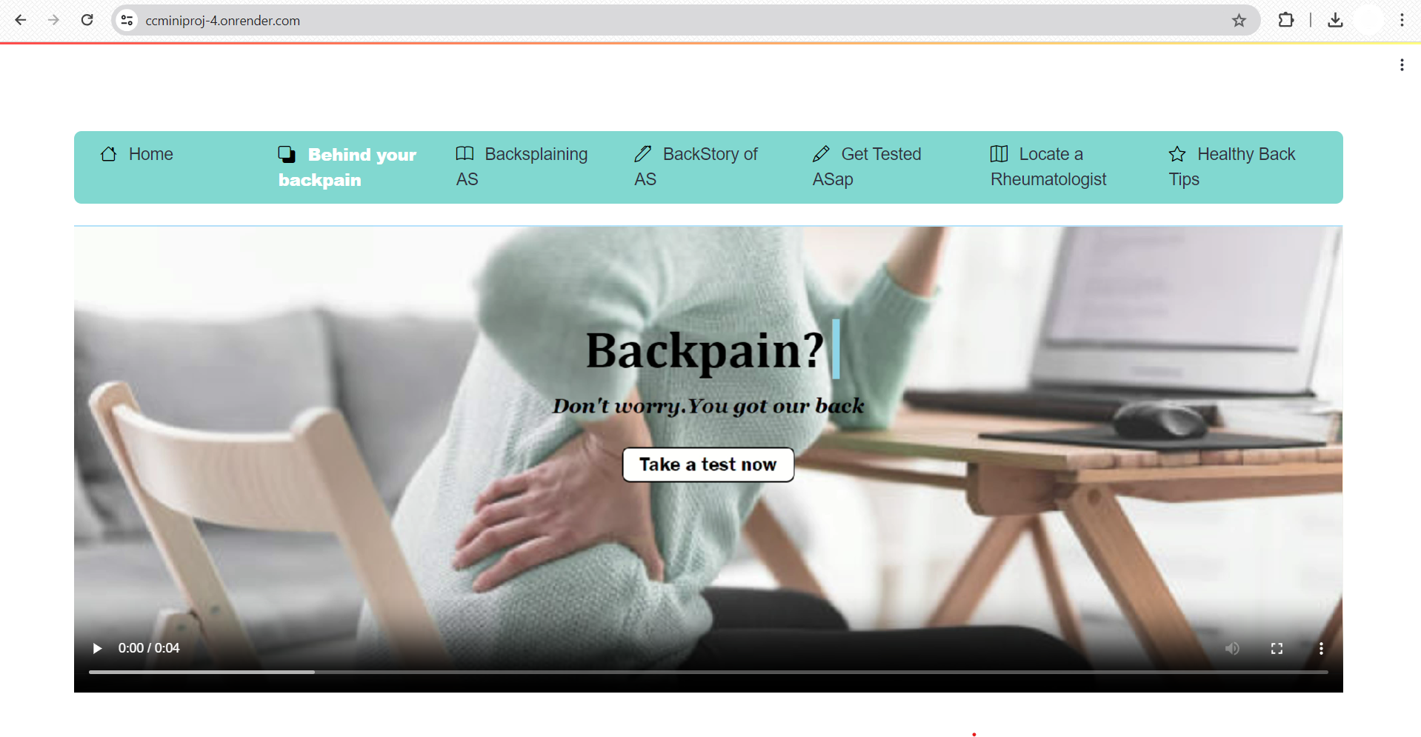
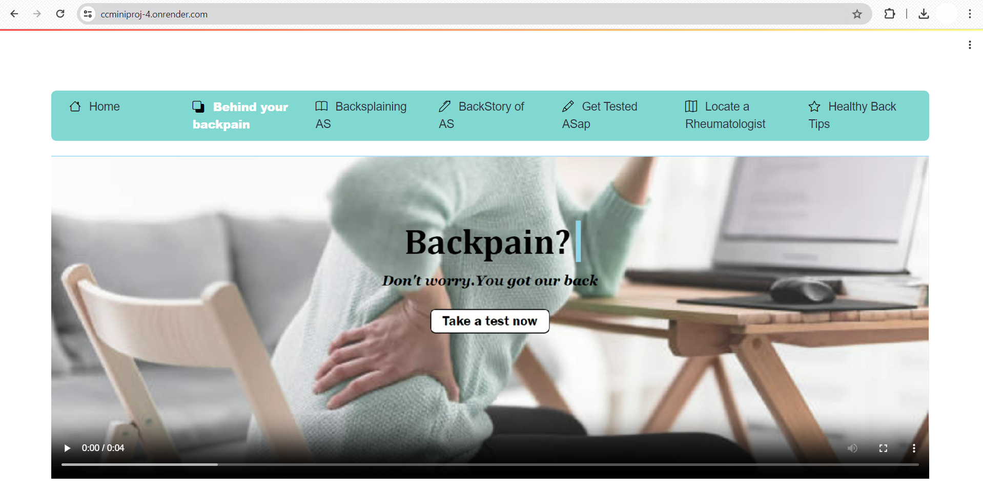
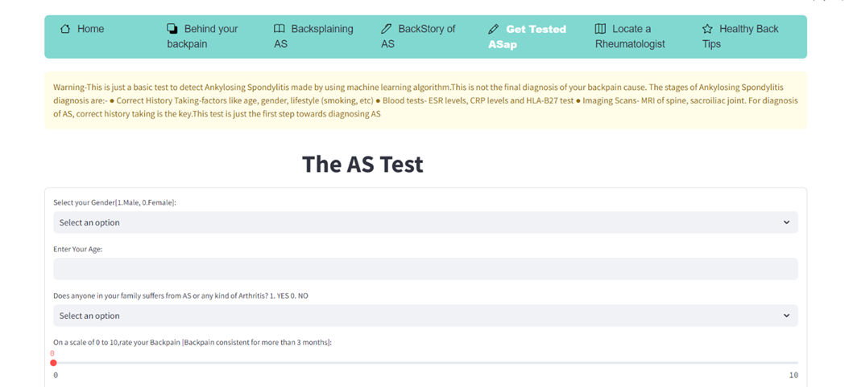

Slide 11

Thank You

